Slide 1

Discrete Mathematics
Chapter 11
Trees

Slide 2
Outline
11.1 Introduction to Trees
11.2 Applications of Trees
11.3 Tree Traversal
11.4 Spanning Trees
11.5 Minimal Spanning Trees

Slide 3
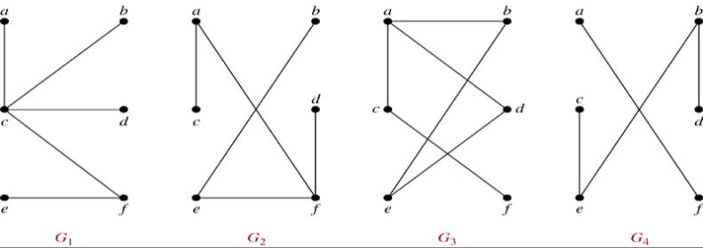
11.1 Introduction to Trees
Def 1 A tree is a connected undirected graph with no simple circuits.
Example 1. Which of the graphs are trees?
Sol: G₁, G₂
Note. 若拿掉connected的條件，就變成 forest

Slide 4
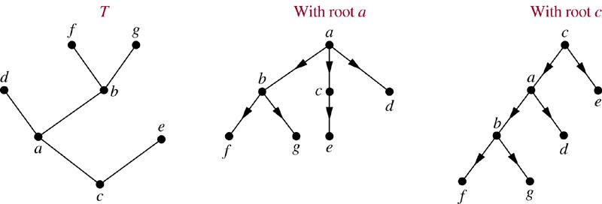
Thm 1. Any undirected graph is a tree if and only if there is a unique simple path between any two of its vertices.
Def 2. A rooted tree is a tree in which one vertex has been designed as the root and every edge is directed away from the root. (箭頭可消掉)
Example

Slide 5
Def: a is the parent of b, b is the child of a, c, d, e are siblings, a, b, d are ancestors of f c, d, e, f, g are descendants of b c, e, f, g are leaves of the tree (deg=1) a, b, d are internal vertices of the tree (at least one child) subtree with d as its root:
a
b
d
c
e
f
g
d
f
g

Slide 6
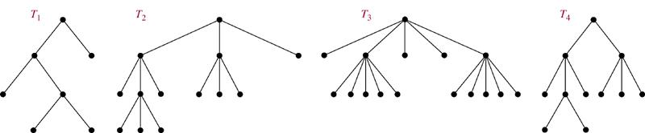
Def 3 A rooted tree is called an m-ary tree if every internal vetex has no more than m children. The tree is called a full m-ary tree if every internal vertex has exactly m children. An m-ary tree with m=2 is called a binary tree.
Example 3
full binary tree
full 3-ary tree
full 5-ary tree
not full 3-ary tree

Slide 7
Def:
a
b
c
left child of a
d
e
f
right child of c
left subtree of a
right subtree of a

Slide 8
Properties of Trees
Thm 2. A tree with n vertices has n−1 edges.
Pf. (by induction on n)
n = 1 : K₁ is the only tree of order 1, |E(K₁)| = 0. ok!
Assume the result is true for every trees of order n = k.
Let T be a tree of order n = k+1, v be a leaf of T, and w be the parent of v.
Let T ’ be the tree T− {v}.
∴|V(T ’)| = k, and |E(T ’)| = k−1 by the induction hypothesis.
⇒ |E(T)| = k
By induction, the result is true for all trees. #

Slide 9
Thm 3. A full m-ary tree with i internal vertices contains n = mi + 1 vertices.
Pf. Every vertex, except the root, is the child of an internal vertex.
Each internal vertex has m children.
⇒ there are mi +1 vertices in the tree
Exercise: 19
Cor. A full m-ary tree with n vertices contains (n−1)/m internal vertices, and hence n − (n−1)/m = ((m−1)n+1)/m leaves.

Slide 10
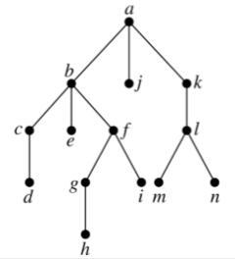
Def: The level of a vertex v in a rooted tree is the length of the unique path from the root to this vertex. The level of the root is defined to be zero. The height of a rooted tree is the maximum of the levels of vertices.
Example 10.
level
0
1
height = 4
2
3
4

Slide 11
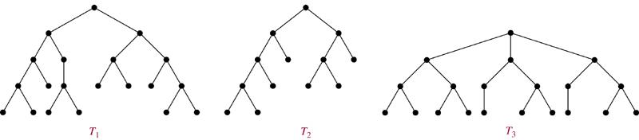
Def: A rooted m-ary tree of height h is balanced if all leaves are at levels h or h−1.
Example 11 Which of the rooted trees shown below are balanced?
Sol. T₁, T₃
Thm 5. There are at most m^{h} leaves in an m-ary tree of height h.

Slide 12
Def: A complete m-ary tree is a full m-ary tree, where every leaf is at the same level.
Ex 28 How many vertices and how many leaves does a complete m-ary tree of height h have?
Sol.
# of vertices = 1+m+m²+…+m^{h} = (m^{h+1}−1)/(m−1)
# of leaves = m^{h}

Slide 13
11.2 Applications of Trees
Binary Search Trees
Goal: Implement a searching algorithm that finds items efficiently when the items are totally ordered.
Binary Search Tree: Binary tree + each child of a vertex is designed as a right or left child, and each vertex v is labeled with a key label(v), which is one of the items.
Note: label(v) > label(w) if w is in the left subtree of v and label(v) < label(w) if w is in the right subtree of v

Slide 14
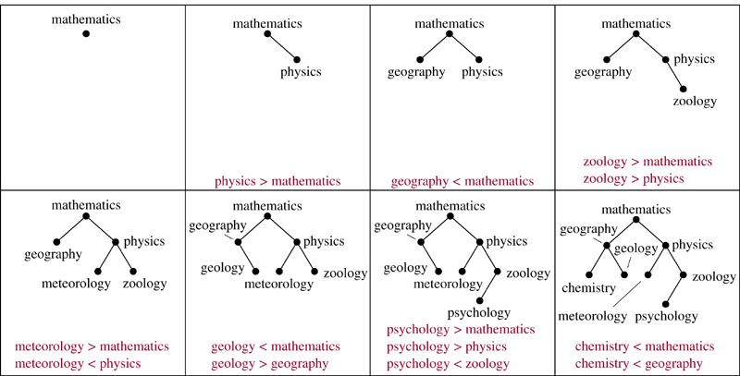
Example 1 Form a binary search tree for the words mathematics, physics, geography, zoology, meteorology, geology, psychology, and chemistry (using alphabetical order).
Sol.

Slide 15
Algorithm 1 (Locating and Adding Items to a Binary Search Tree.)
Procedure insertion(T: binary search tree, x: item)
v := root of T
{a vertex not present in T has the value null}
while v ≠ null and label(v) ≠ x
begin
if x < label(v) then
if left child of v ≠ null then v:=left child of v else add new vertex as a left child of v and set v := null
else if right child of v ≠ null then v:= right child of v else add new vertex as a right child of v and set v := null
end
if root of T = null then add a vertex v to the tree and label it with x
else if v is null or label(v) ≠ x then label new vertex with x and let v be this new vertex
{v = location of x}

Slide 16
Example 2 Use Algorithm 1 to insert the word oceanography into the binary search tree in Example 1.
Sol.
label(v) = mathematics < oceanography
mathematics
label(v) = physics > oceanography
v
label(v) = meteorology < oceanography
geography
physics
meteorology
zoology
chemistry
geology
oceanography
psychology
Exercise: 1,3

Slide 17
Decision Trees
A rooted tree in which each internal vertex corresponds to a decision, with a subtree at these vertices for each possible outcome of the decision, is called a decision tree.
Example 3 Suppose there are seven coins, all with the same weight, and a counterfeit (偽造) coin that weights less than the others. How many weighings (秤重) are necessary using a balance scale (秤) to determine which of the eight coins is the counterfeit one? Give an algorithm for finding this counterfeit coin.

Slide 18
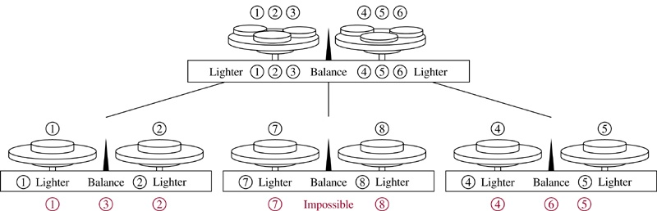
Sol.
秤重時，可能左重、右重或平衡 ⇒ 3-ary tree
Need 8 leaves ⇒ 至少需秤重兩次
Exercise: 7

Slide 19
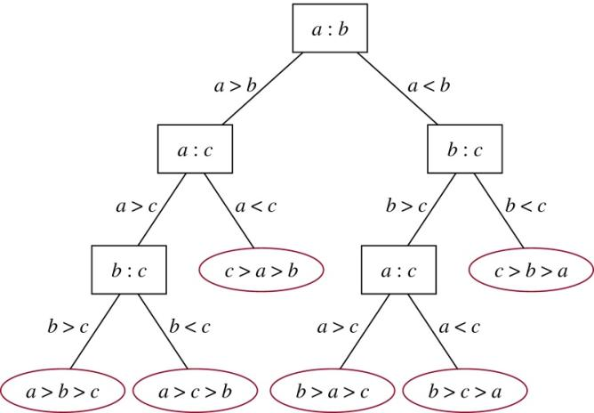
Example 4 A decision tree that orders the elements of the list a, b, c.
Sol.

Slide 20
Prefix Codes
Problem: Using bit strings to encode the letter of the English alphabet (不分大小寫)
⇒ each letter needs a bit string of length 5 (因 2⁴ < 26 < 2⁵)
Is it possible to find a coding scheme of these letter such that when data are coded, fewer bits are used?
Encode letters using varying numbers of bits.
Some methods must be used to determine where the bits for each character start and end.
⇒ Prefix codes: Codes with the property that the bit string for a letter never occurs as the first part of the bit string for another letter.
Notes:
p:\msoffice\My Projects\Rosen 6e 2007\Imagebank\JPEGs07-24-06\ch10\jpeg\10_2_04.jpg

Slide 21
Example: (not prefix code) e : 0, a : 1, t : 01 The string 0101 could correspond to eat, tea, eaea, or tt.
Example: (prefix code) e : 0, a : 10, t : 11 The string 10110 is the encoding of ate.

Slide 22
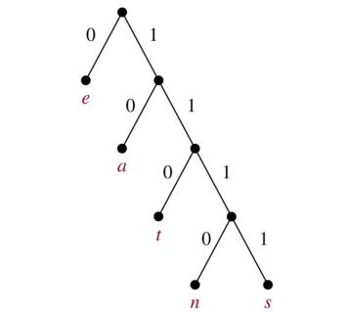
A prefix code can be represented using a binary tree.
character: the label of the leaf edge label: left child → 0, right child → 1
The bit string used to encode a character is the sequence of labels of the edges in the unique path from the root to the leaf that has this character as its label.
Example:
從root走起，到leaf為止，重複
encode
e : 0 a : 10 t : 110 n : 1110 s : 1111
decode
11111011100
s
a
n
e
⇒ sane
Exercise: 22

Slide 23
Huffman Coding (data compression重要工具)
Input the frequencies of symbols in a string and output a prefix code that encodes the string using the fewest possible bits, among all possible binary prefix codes for these symbols.
一開始有很多孤立點，label就是各個symbol，
將最少使用的兩個symbol結合成一個subtree，
重複此一概念，
將最少使用的兩個subtree結合成一個subtree，…

Slide 24
Algorithm 2 (Huffman Coding)
Procedure Huffman(C: symbols a_{i} with frequencies w_{i}, i = 1, …, n)
F := forest of n rooted trees, each consisting of the single vertex a_{i} and assigned weighted w_{i}
while F is not a tree
begin
Replace the rooted trees T and T’ of least weights from F with w(T) ≥ w(T’) with a tree having a new root that has T as its left subtree and T’ as its right subtree. Label the new edge to T with 0 and the new edge to T’ with 1.
Assign w(T)+w(T’) as the weight of the new tree.
end

Slide 25
Example 5 Use Huffman coding to encode the following symbols with the frequencies listed: A: 0.08, B: 0.10, C: 0.12, D: 0.15, E: 0.20, F: 0.35. What is the average number of bits used to encode a character?
Sol: 1. 下頁圖
2. The average number of bits is: 每個symbol 長度× 頻率 的加總 = 3×0.08+ 3×0.10+ 3×0.12+ 3×0.15+2×0.20+2×0.35 =2.45
Exercise : 23

Slide 26
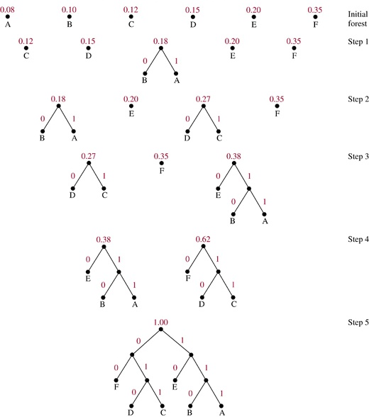

Slide 27
11.3 Tree Traversal
We need procedures for visiting each vertex of an ordered rooted tree to access data.
Universal Address Systems
Label vertices:
root → 0, its k children → 1, 2, …, k (from left to right)
For each vertex v at level n with label A, its r children → A.1, A.2, …, A.r (from left to right).
We can totally order the vertices using the lexicographic ordering of their labels in the universal address system.
x₁.x₂…..x_{n} < y₁.y₂…..y_{m} if there is an i, 0 ≤ i ≤ n, with x₁=y₁, x₂=y₂, …, x_{i-1}=y_{i-1}, and x_{i}<y_{i}; or if n<m and x_{i}=y_{i} for i=1, 2, …, n.

Slide 28
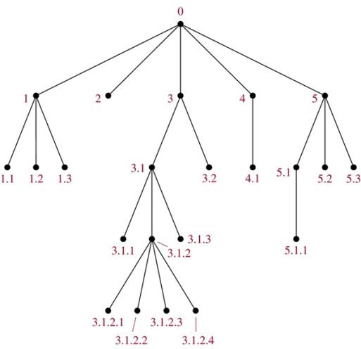
Example 1
The lexicographic ordering is: 0 < 1<1.1 < 1.2 < 1.3 < 2 < 3 < 3.1 < 3.1.1 < 3.1.2 < 3.1.2.1 < 3.1.2.2 < 3.1.2.3 < 3.1.2.4 < 3.1.3 < 3.2 < 4 < 4.1 < 5 < 5.1 < 5.1.1 < 5.2 < 5.3
Exercise : 2

Slide 29
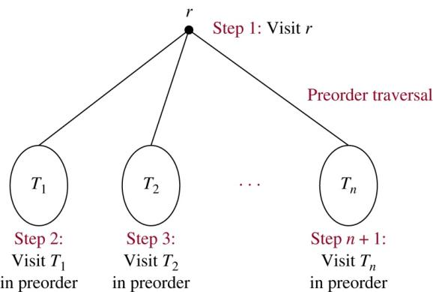
Traversal Algorithms
Preorder traversal (前序)

Slide 30
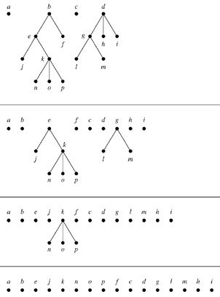
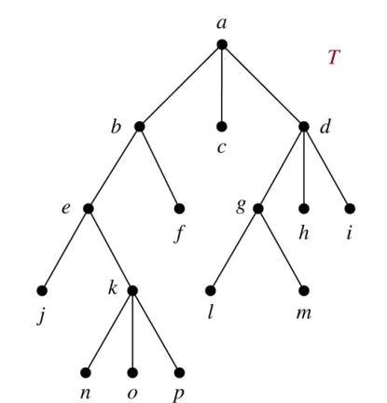
Example 2. In which order does a preorder traversal visit the vertices in the ordered rooted tree T shown below?
Sol:

Slide 31
Algorithm 1 (Preorder Traversal)
Procedure preorder(T: ordered rooted tree)
r := root of T
list r
for each child c of r from left to right
begin
T(c) := subtree with c as its root
preorder(T(c))
end
Exercise : 8

Slide 32
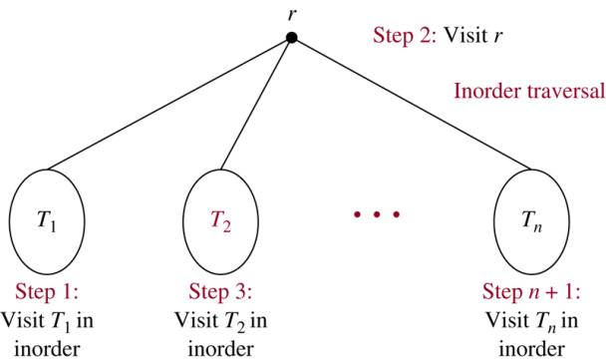
Inorder traversal(中序)

Slide 33
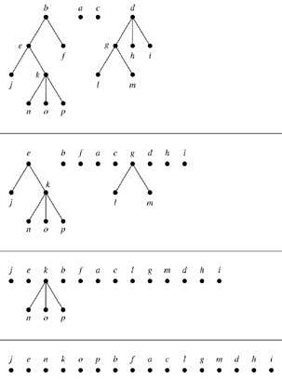
Example 3. In which order does a preorder traversal visit the vertices in the ordered rooted tree T shown below?
Sol:

Slide 34
Algorithm 2 (Inorder Traversal)
Procedure inorder(T: ordered rooted tree)
r := root of T
If r is a leaf then list r
else
begin
l := first child of r from left to right
T(l) := subtree with l as its root
inorder(T(l))
list r
for each child c of r except for l from left to right
T(c) := subtree with c as its root
inorder(T(c))
end

Slide 35
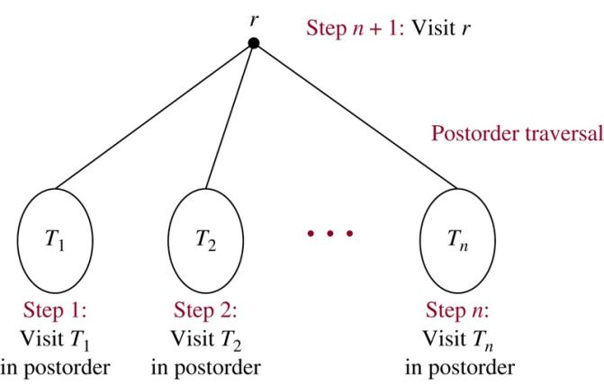
Postorder traversal(後序)

Slide 36
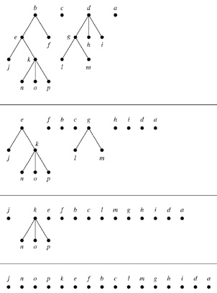
Example 4. In which order does a preorder traversal visit the vertices in the ordered rooted tree T shown below?
Sol:

Slide 37
Algorithm 3 (Postorder Traversal)
Procedure postorder(T: ordered rooted tree)
r := root of T
for each child c of r from left to right
begin
T(c) := subtree with c as its root
postorder(T(c))
end
list r

Slide 38
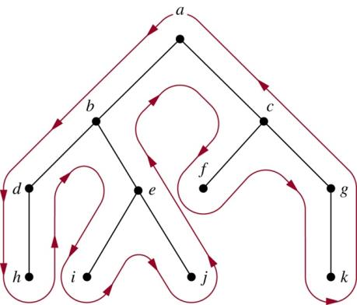
比較容易的表示法：依紅線的走法拜訪節點
Preorder: curve第一次通過該點時就list該節點
Inorder: curve第一次通過一個leaf時就list它，第二次通過一個internal節點 時就list它
Postorder: curve最後一次通過該點時就list該節點
Preorder: a, b, d, h, e, i, j, c, f, g, k
Inorder: h, d, b, i, e, j, a, f, c, k, g
Postorder: h, d, i, j, e, b, f, k, g, c, a

Slide 39
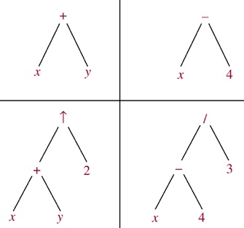
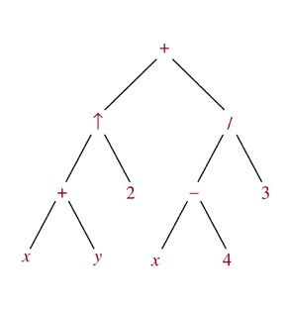
Infix, Prefix, and Postfix Notation
We can represent complicated expressions, such as compound propositions, combinations of sets, and arithmetic expressions using ordered rooted trees.
Example 1 Find the ordered rooted tree for ((x+y)↑2)+((x−4)/3). (↑表示次方)
Sol.
leaf: variable internal vertex: operation on its left and right subtrees

Slide 40
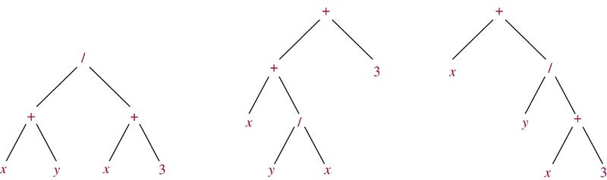
The following binary trees represent the expressions: (x+y)/(x+3), (x+(y/x))+3, x+(y/(x+3)). All their inorder traversals lead to x+y/x+3 ⇒ ambiguous ⇒ need parentheses
Infix form: An expression obtained when we traverse its rooted tree with inorder. Prefix form: … … by preorder. (also named Polish notation) Postfix form: … … by postorder. (reverse Polish notation)

Slide 41
Example 6 What is the prefix form for ((x+y)↑2)+((x−4)/3)?
Sol.
+ ↑ + x y 2 / − x 4 3
Example 8 What is the postfix form of the expression ((x+y)↑2)+((x−4)/3)?
Sol.
x y + 2 ↑ x 4 − 3 / +
Note. An expression in prefix form or postfix form is unambiguous, so no parentheses are needed.

Slide 42
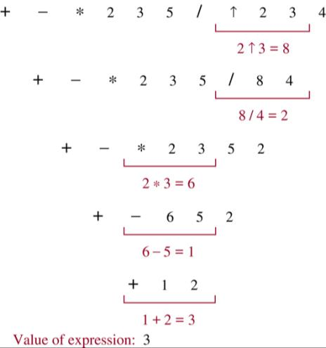
Example 7 What is the value of the prefix expression + − * 2 3 5 / ↑ 2 3 4?
Sol.
由右到左運算，將第一個出現的 運算記號(如↑)右邊的兩個數字 做此運算，運算結果取代原先位置， 依此類推。

Slide 43
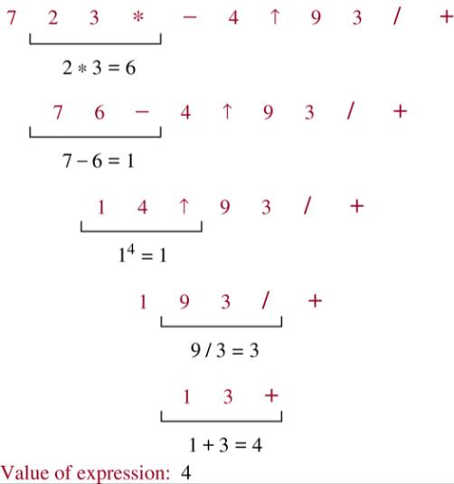
Example 9 What is the value of the postfix expression 7 2 3 * − 4 ↑ 9 3 / +?
Sol.
由左到右運算，將第一個出現的 運算記號(如*)左邊的兩個數字 做此運算，運算結果取代原先位 置，依此類推。

Slide 44
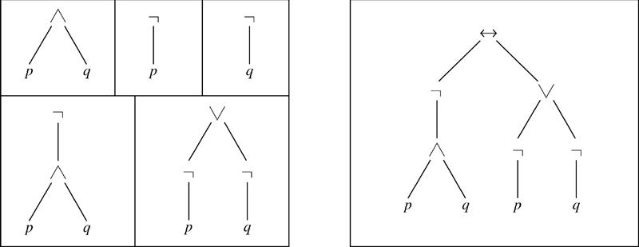
Example 10 Find the ordered rooted tree representing the compound proposition (¬(p∧q)) ↔ (¬p∨¬q). Then use this rooted tree to find the prefix, postfix, and infix forms of this expression.
Sol.
prefix: ↔ ¬ ∧ p q ∨ ¬ p ¬ q
infix: (¬(p∧q)) ↔ ((¬p)∨(¬q))
postfix: p q ∧ ¬ p ¬ q ¬ ∨ ↔
Exercise : 17, 23, 24

Slide 45
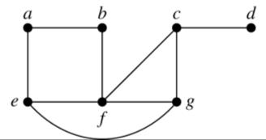
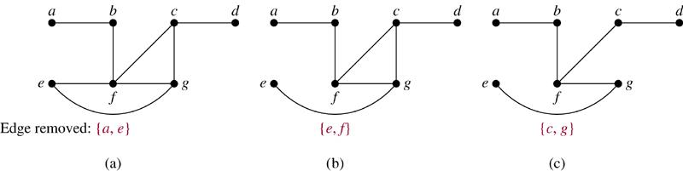
11.4 Spanning Trees
Introduction
Def. Let G be a simple graph. A spanning tree of G is a subgraph of G that is a tree containing every vertex of G.
Example 1 Find a spanning tree of G.
Sol.
Remove an edge from any circuit. (repeat until no circuit exists)

Slide 46
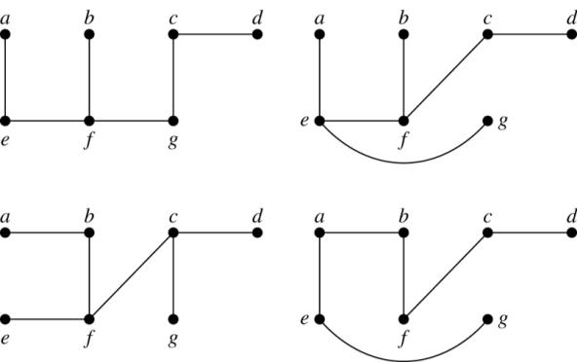
Four spanning trees of G:
Exercise : 1, 8, 11
Thm 1 A simple graph is connected if and only if it has a spanning tree.
Exercise : 24, 25

Slide 47
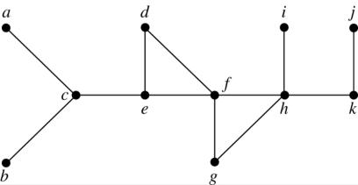
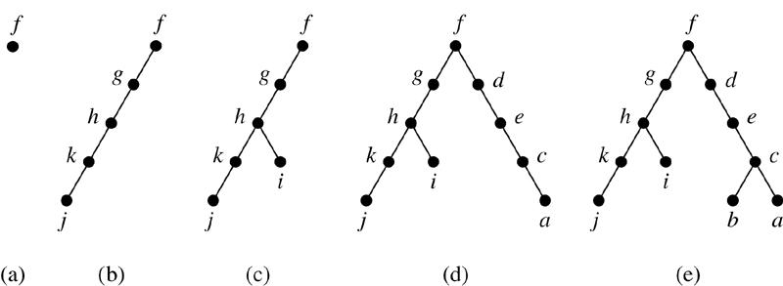
Depth-First Search (DFS)
Example 3 Use depth-first search to find a spanning tree for the graph.
Sol. (arbitrarily start with the vertex f)

Slide 48
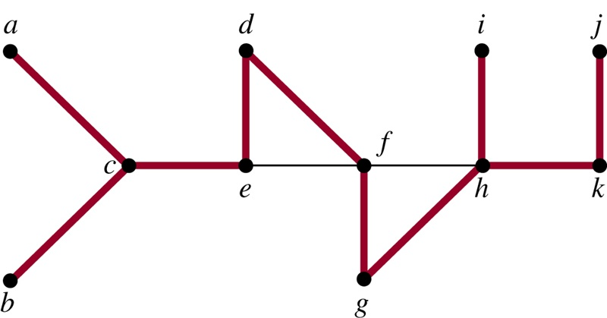
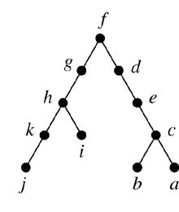
The edges selected by DFS of a graph are called tree edges. All other edges of the graph must connect a vertex to an ancestor or descendant of this vertex in the tree. These edges are called back edges.
Example 4 (承上題)
⇒
The tree edges (red) and back edges (black)

Slide 49
Algorithm 1 (Depth-First Search)
Procedure DFS(G: connected graph with vertices v₁, v₂, …, v_{n})
T := tree consisting only of the vertex v₁
visit(v₁)
procedure visit(v: vertex of G)
for each vertex w adjacent to v and not yet in T
begin
add vertex w and edge {v, w} to T
visit(w)
end
Exercise : 13

Slide 50
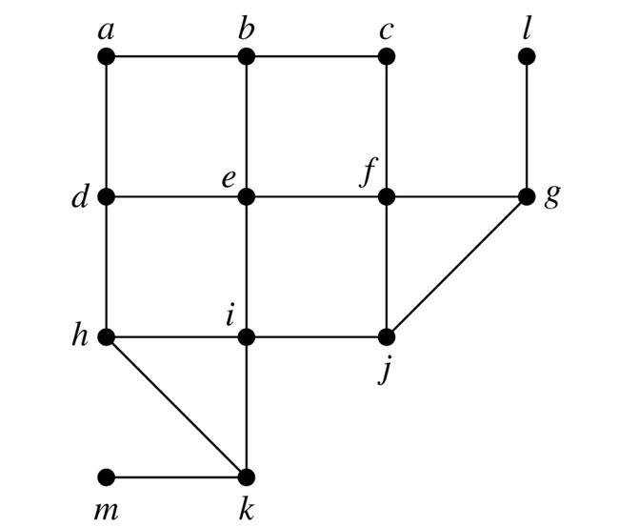
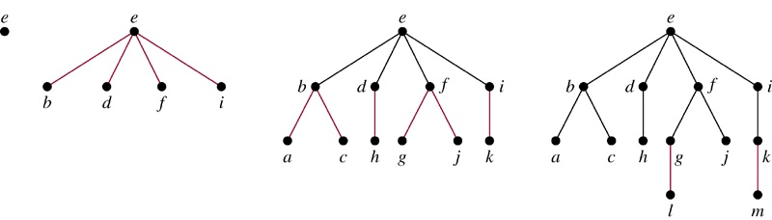
Breadth-First Search (BFS)
Example 5 Use breadth-first search to find a spanning tree for the graph.
Sol. (arbitrarily start with the vertex e)

Slide 51
Algorithm 2 (Breadth-First Search)
Procedure BFS(G: connected graph with vertices v₁, v₂, …, v_{n})
T := tree consisting only of vertex v₁
L := empty list
put v₁ in the list L of unprocessed vertices
while L is not empty
begin
remove the first vertex v from L
for each neighbor w of v
if w is not in L and not in T then
begin
add w to the end of the list L
add w and edge {v, w} to T
end
end
Exercise : 16

Slide 52
Backtracking Applications
There are problems that can be solved only by performing an exhaustive (徹底的) search of all possible solutions.
Decision tree: each internal vertex represents a decision, and each leaf is a possible solution.
To find a solution via backtracking: 在 decision tree上由root做 一連串的decision走到leaf，若leaf不是solution，或整個子樹 檢查完未找到解，則退到上層parent，改找另一個子樹。

Slide 53
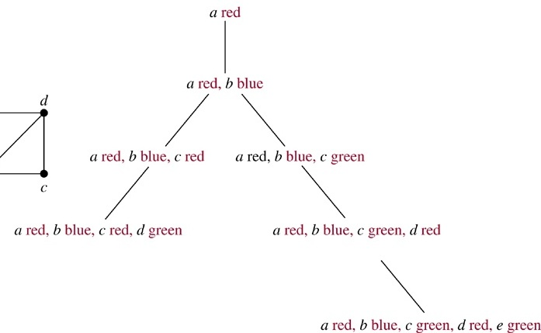
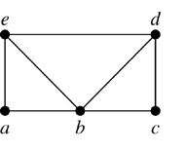
Example 6 (Graph Colorings) How can backtracking be used to decide whether the following graph can be colored using 3 colors?
Sol.

Slide 54
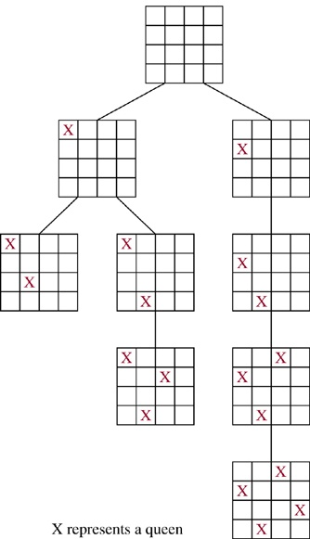
Example 7 (The n-Queens Problem) The n-queens problem asks how n queens can be placed on an n×n chessboard so that no two queens can attack on another. How can backtracking be used to solve the n-queens problem.
Sol.
以n=4為例
3rd column不能放

Slide 55
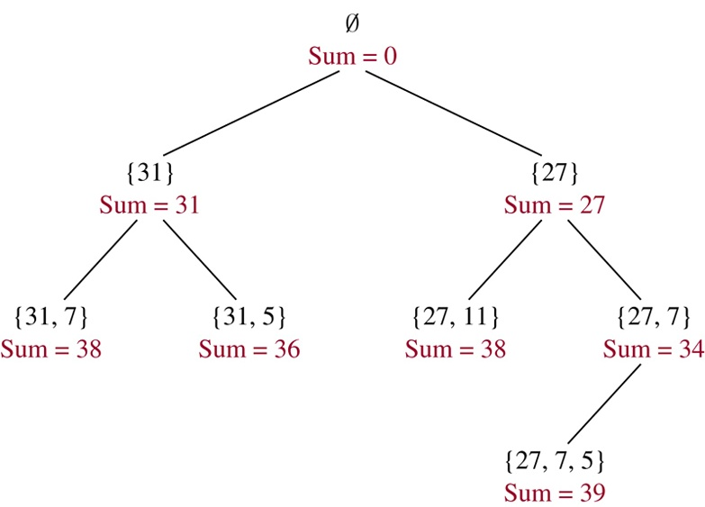
Example 8 (Sum of Subsets) Give a set S of positive integers x₁, x₂, …, x_{n}, find a subset of S that has M as its sum. How can backtracking be used to solve this problem.
Sol.
S = {31, 27, 15, 11, 7, 5} M = 39
Exercise : 30

Slide 56
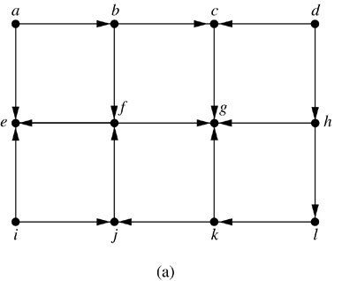
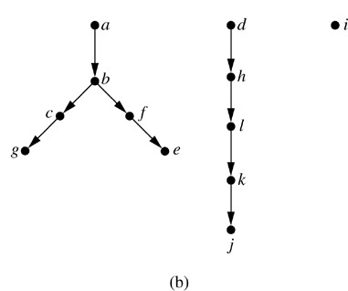
Depth-First Search in Directed Graphs
Example 9 What is the output of DFS given the graph G?
Sol.

Slide 57
11.5 Minimum Spanning Trees
G: connected weighted graph (each edge has an weight ≥ 0)
Def. minimum spanning tree of G: a spanning tree of G with smallest sum of weights of its edges.
Algorithms for Minimum Spanning Trees
Algorithm 1 (Prim’s Algorithm)
Procedure Prim(G: connected weighted undirected graph with n vertices)
T := a minimum-weight edge
for i := 1 to n−2
begin
e := an edge of minimum weight incident to a vertex in T and not forming a simple circuit in T if added to T
T := T with e added
end {T is a minimum spanning tree of G}

Slide 58
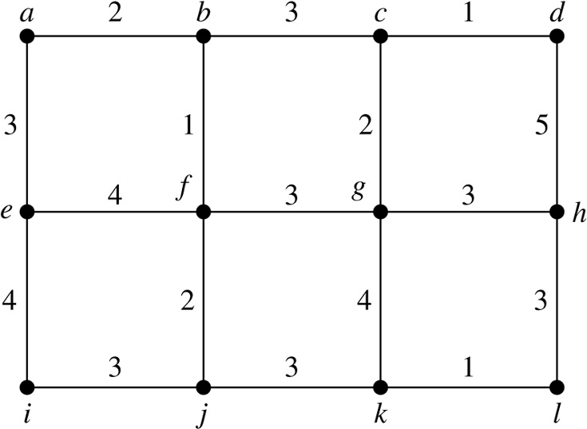
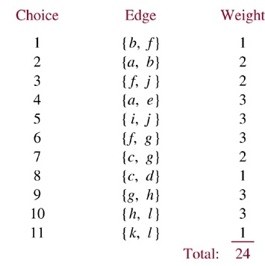
Example 2 Use Prim’s algorithm to find a minimum spanning tree of G.
Sol.
(過程中維持只有一個tree)
Exercise: 3

Slide 59
Algorithm 2 (Kruskal Algorithm)
Procedure Kruskal(G: connected weighted undirected graph with n vertices)
T := empty graph
for i := 1 to n−1
begin
e := any edge in G with smallest weight that does not form a simple circuit when added to T
T := T with e added
end {T is a minimum spanning tree of G}

Slide 60
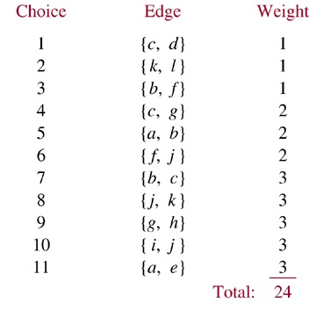
Example 3 Use Kruskal algorithm to find a minimum spanning tree of G.
Sol.
(過程中tree通常會有好幾個)
Exercise: 7

